Slide 1
Kappa Psi Service Grant Application Guide
Northern Plains Province Professional Development Resource Series
Brother Kranz, Chaplain

Slide 2
Service Grant Applications
The Kappa Psi Service Grants are awarded nationally to chapters who submit ideas to improve and assist their communities.
Serving the community hosting your chapter and college in an industrious and philanthropic way is a wonderful part of being a brother.
First implemented in 2018, an award of 1000 dollars is given to each of 10 chapters who propose genuine and service driven ideas to assist their communities. This 1000-dollar award is used for the project and can be a wonderful legacy for your chapter.
Please read on to understand the service grant, and how to apply for it using three easy steps.
One application is typically submitted per chapter.

Slide 3
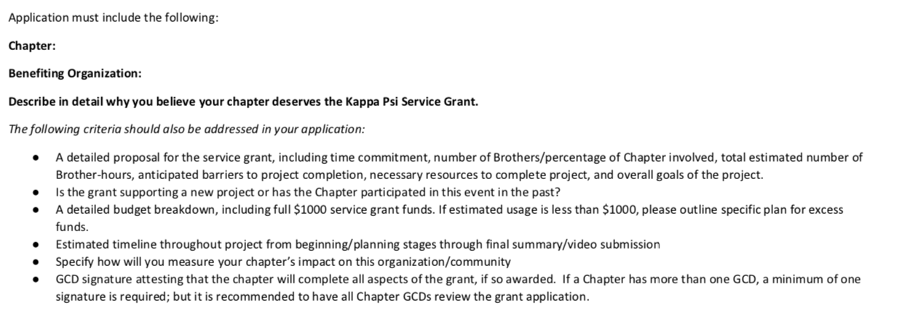
Components of an Application
Following this application carefully will ensure a strong submission.
Much of this is completed only by communication with a project site and brothers in your chapter. See steps 1 and 3.

Slide 4
Step 1. Developing an Idea
Ask brothers and members of your community who would best benefit from a service grant.
Demonstrating the potential impact of your project is important in your application, so try to contact a person or organization on a mission in your community who could help you make a specific plan for your funds.
This can be an after-school program, children’s hospital, library, clinic, school, or other institution.
Contact the proposed site and begin talking about ideas. Begin your application and work to formulate a plan with them.
Follow the service grant application instructions as closely as you can when you begin to write up your idea.
See my past submissions on future slides.

Slide 5
Step 2. Create a Team and Timeline for your Project
If you haven’t already assembled a dedicated team to work with you on this project, now would be a good time to do so.
Select about three to five brothers to fulfill key roles in your project. One can be a contact person, another handles use of the funds, etc. Include these roles when you write your application.
Look ahead and create a projected timeline gauging how long each stage of your project should take.
You can work together with your team to better anticipate how long each stage should take. Further, this is a good time to determine what obstacles will come up.
You may have to adjust your schedule and call on extra support—but having a core team and a solid schedule will be critical in pushing your project forward. Schedule adjustments can be communicated with the national philanthropy committee, and your site contact person.
Example Timeline

Slide 6
Step 3. Perform Communication with your Project Site.
Establish a contact person at your site to whom you can direct questions throughout the process.
Designate a brother on your team to act as a liaison between your group and the site.
Speak about ideas and budgeting for a project. While you may not have every detail and dollar allotted in your budget, you should have a general idea of how you will utilize your grant money and especially be able to list what will occur with unused funds.
Get a feel for your project site’s values and listen to what they need to put the finishing touches on your project.
Make sure site understands that you are in the process of applying for money to carry out the project idea.

Slide 7
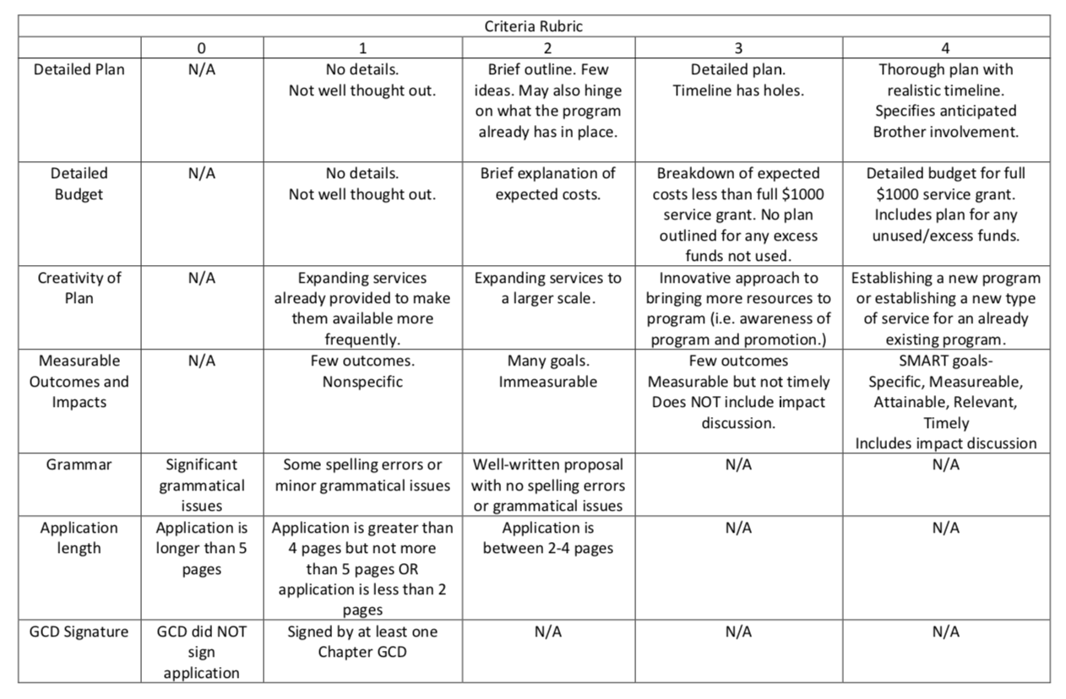
Self Assessing Your Application
Look over the rubric thoroughly with your team and GCD to ensure you are not losing points unnecessarily.
Easiest ways to retain points you control are detailed planning, grammar, page count etc. Do not lose these points.
Prioritize an idea for a project or community partnerships with lasting impacts or starting a new community event.
Avoid requesting a grant for events you have done in the past where possible.
Submit with GCD application by October 23rd.

Slide 8
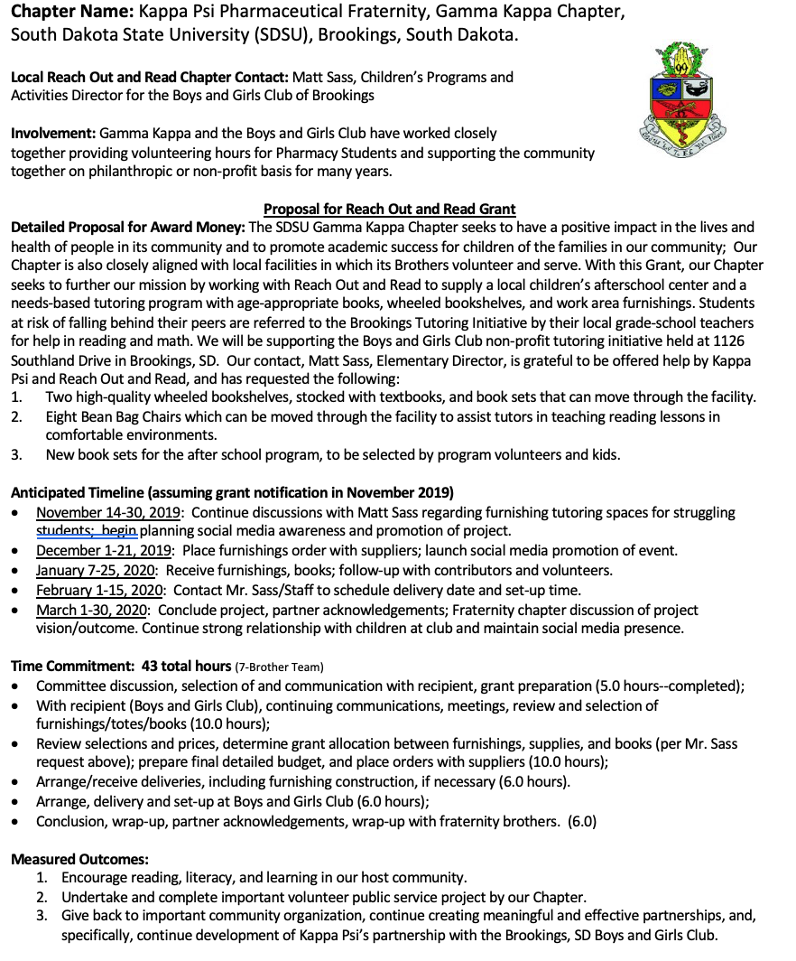
Example 1. Successful Grant 2019

Slide 9
Example 2. Successful Grant 2018

Slide 10
Closing Points, Best of Luck NPP! Contact robert.kranz@jacks.sdstate.edu with questions!
All application materials should be submitted to philanthropy@kappapsi.org no later than Friday, October 23, 2020. Please read over the entire application, including the grading rubric on the second page, and direct any questions regarding the application form or the grants in general to philanthropy@kappapsi.org.
Grant recipients will be required to submit a written summary of the event (including the impact on the community) and a 5-minute video highlighting their work with the award funds by May 15, 2021.

